Slide 1
Extentia: QA PRACTICE
Draft 2.0 (March-21)

Slide 2

Our Testing-as-a-Service Offering
Provide end-to-end enterprise Testing as a Service (eTaaS)
Flexible engagement models to suit customer situations
Covers entire gamut of test activities and outcomes

Slide 3
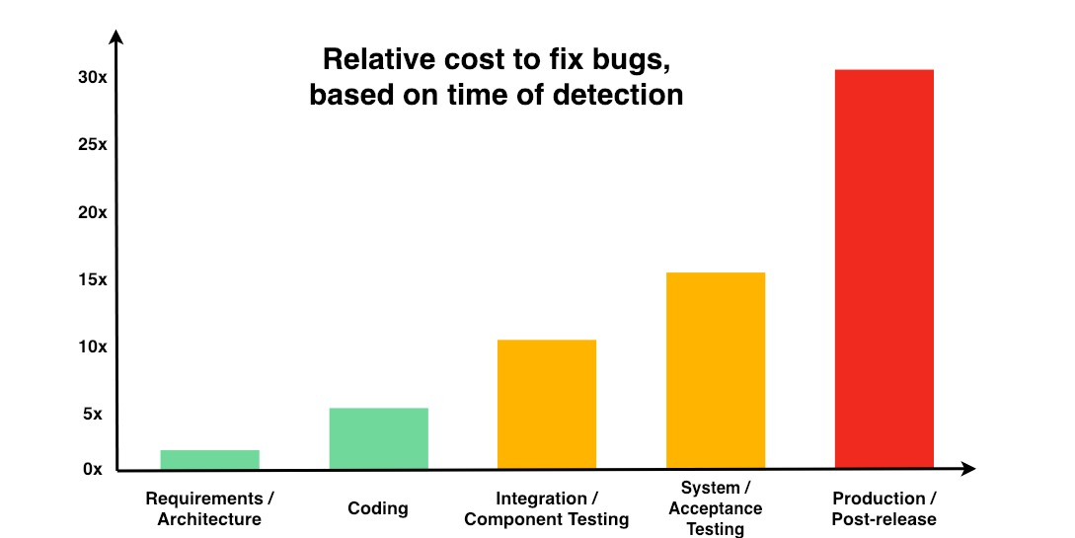
Quality Assurance Philosophy
Ensuring high quality of delivery through:
“Test early, test often” principle
Business-objective centric
Data driven
Addresses functional and non-functional aspects
Adaptive, agile and nimble to align to different engagement models
QA-QC-QE Approach – Guided by PDCA (Plan-Do-Check-Act)
As per the Systems Sciences Institute at IBM report: “The cost to fix an error found after product release was four to five times as much as one uncovered during design, and up to 100 times more than one identified in the maintenance phase.”

Slide 4

Quality Assurance in our Application Development
QA is a mandatory function of every application development
Each development project has a dedicated QA team
QA team has an independent reporting line
Established QA Center of Excellence sets standards, tools, and processes
Set up for innovation and continuous improvements
Flexible to work across waterfall or agile or hybrid models

Slide 5

Testing Lifecycle
Through Quality Assurance we take control of:
Requirement Analysis
Test Strategy and Planning
Test Design
Test Infrastructure and Data Setup
Test Execution
Defect Management
Reporting
RCA
Lessons Learnt

Slide 6
Testing Types
Functional Testing
Business Rules and Workflow Testing
UI/UX Testing
Integration Testing
Mobile device Testing
Acceptance Testing
Automation Testing
Security Testing
Smoke/Sanity Testing
Load, Volume and Stress Testing
Accessibility Testing
A/B Testing

Slide 7
Extentia Testing Process
Identification of requirements to be tested during the sprint planning/project initiation phase based on the product backlog
Estimate and develop the testing strategy based on product specifics in line with the stories selected for the sprint
Determine coverage based on risk and practicality
Determine testing procedures – automated, manual, exploratory and non-functional
Design the test cases and test data based upon the functional requirement documents
Functional test case execution and management of test cases on the test environment set
Report defects on the bug tracking tool and perform regression testing for bug fixes done
Preparation of test completion documentation and test metrics
Maintenance of test cases which is a very important part of the whole process

Slide 8
Extentia Testing Process
Testing Process
Test Planning , Monitoring and Control
Test Analysis and Design
Test Management
Risk-based Testing
Test Documentation
Test Implementation and Execution
Test Closure Activities
Evaluation Exist Criteria and Reporting
Test Estimation and Test Matrices
Business Logic Testing
Managing the Application of Industry Standards
Reviews
Defect Management
Management Reviews
Managing Reviews
Metrics for Reviews
Defect Lifecycle
Defect Report Information
Assessing Process Capability with Defect Report Info
Improving the Testing Process
Test Improvement Process
Test Tools and Automation
Tool Selection
Tool Metrices
Requirement
Review of Requirement Specification, User Acceptance Test Plans
Design
Review of Software Designs
Coding
Unit/Component Testing
System Test Case Writing
Testing
Test Execution
Non-Functional Testing
Maintenance
Regression Tests (Manual/Automation)

Slide 9

Touch Point – Communication Methodology
Customer interactions are very important, especially when working in an onshore/offshore model
Continuous level of collaboration between all parties is important – we ensure efficiency in this by:
Daily sync-up calls – Updates, set priorities, status
Weekly sync-ups – Overview about the offshore team’s achievements, next week’s plan, coming milestones and risks & issues
Regular demos to be in sync with Product Owner’s expectations/feedback
Sprint retrospective meeting – Sprint assessment/ improvements
Virtual Stand-up –
#Last24 – What we did in last 24hrs
#Next24 – What are we going to do in next 24hrs
Preferred communication channel – Jira/Wiki/Email/MS Teams/Over Call

Slide 10
Touch Point – Testing Activities
Requirement Understanding and Documentation
Story grooming sessions – Ensuring QA involvement
Documenting all test cases as per user acceptance criteria
Review
Ensure all test case scenarios are covered
Execution
Execute test cases and provide timely updates
Review all test cases and sign off by Product Owner
Ensure the testing environment is up and running
Issues
All issues found will be logged with appropriate priority – assigned to the respective developer and linked to user story
Testing of existing functionality and call out any issues (old/new) that may impact testing
All issues in minor to be reviewed by Product Owner and PM
Ready for Release
User story is moved here only when all bugs are successfully retested and closed
All issues under Blocker, Critical and Major priority

Slide 11
Quality Control
Extentia caters to both functional and non-functional testing, through either manual or automation mode in order to achieve:
Test case coverage – Test cases mapped against each requirement
Test case quality – Test cases valid and available to execute
Test case execution – Number of test cases executed per resource/per day
Defect – Improved defect detection, reduced defect leakage
Defect efficiency ratio – Number of defects found/number of test cases executed

Slide 12
Test Management
Tracking of Test Activities
We recommend having a test management tool in place to track all testing activities
Jira or Testlink (Open Source) is the preferred option
Bug Reporting/Tracking
To make sure that all the required details are there in the defect including good summary, environment description, proper steps, attachments/screenshots etc.
We are also familiar with managing tests in Bugzilla, Mantis, Test Track Pro, Azure DevOps etc.

Slide 13
Test Deliverables
Test Plan
Test Execution
Test Design
Analysis
Strategy
Plan
Tools
Test Cases
Test Scripts
Test Scenarios
Test Report
Defect Tracking
Defect Analysis

Slide 14
Test Plan
Defines the overall strategy for testing software.
Explains level of testing and Testing environment.
Imparts information on how test results will be analyzed, and which metrics will be used for the purpose.
Entry and Exit criteria for each phase are defined
Estimate of test effort
Test Plan
Test Specification
Test Code
Execute
Review Test

Slide 15
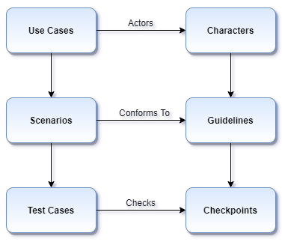
Test Scenarios and Test Cases
Action
Input Data
Test Case
Expected Results

Slide 16

Test Metrics/Reporting
We maintain metrics generated by Test Management tools:
General test plan metrics
Overall build status
Query metrics (user can form a query for e.g. build, top level test suite start time, end time etc.)
Failed test cases
Blocked test cases
Not run test cases
Total bugs for each test case
Charts (pie charts etc.)

Slide 17
Test Reports
Daily Test Report
How many test cases were planned for the day?
How many of them were executed?
How many defects have been reported by the testing team?
How many of the defects were critical?
Incident Report
Comparison of actual and expected results
What was the cause of deviation in cases where tests failed? – faulty test automation, poor test case, actual failure of software?

Slide 18






Tool Selection
Quality Assurance | Quality Control | Quality Engineering
Test Management – HP QC/ALM, qTest | Functional Automation – Selenium, HP QTP/ UFT, TOSCA | Performance Engineering – SiteScope
Agile Project Management – JIRA, Confluence | API Testing – ReadyAPI | Performance Monitoring – TestRelic, Dynatrace
Requirement Management – JAMA | Performance Testing – JMeter
DevOps –TFS | Performance Testing – LoadRunner
DevOps – VSTS | Security Testing (VA-PT) – Burp

Slide 19





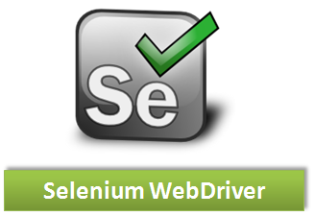



















Tools and Technology Expertise
RDBMS

